Slide 1

Yasin Kereci
SA II / 23A

Slide 2

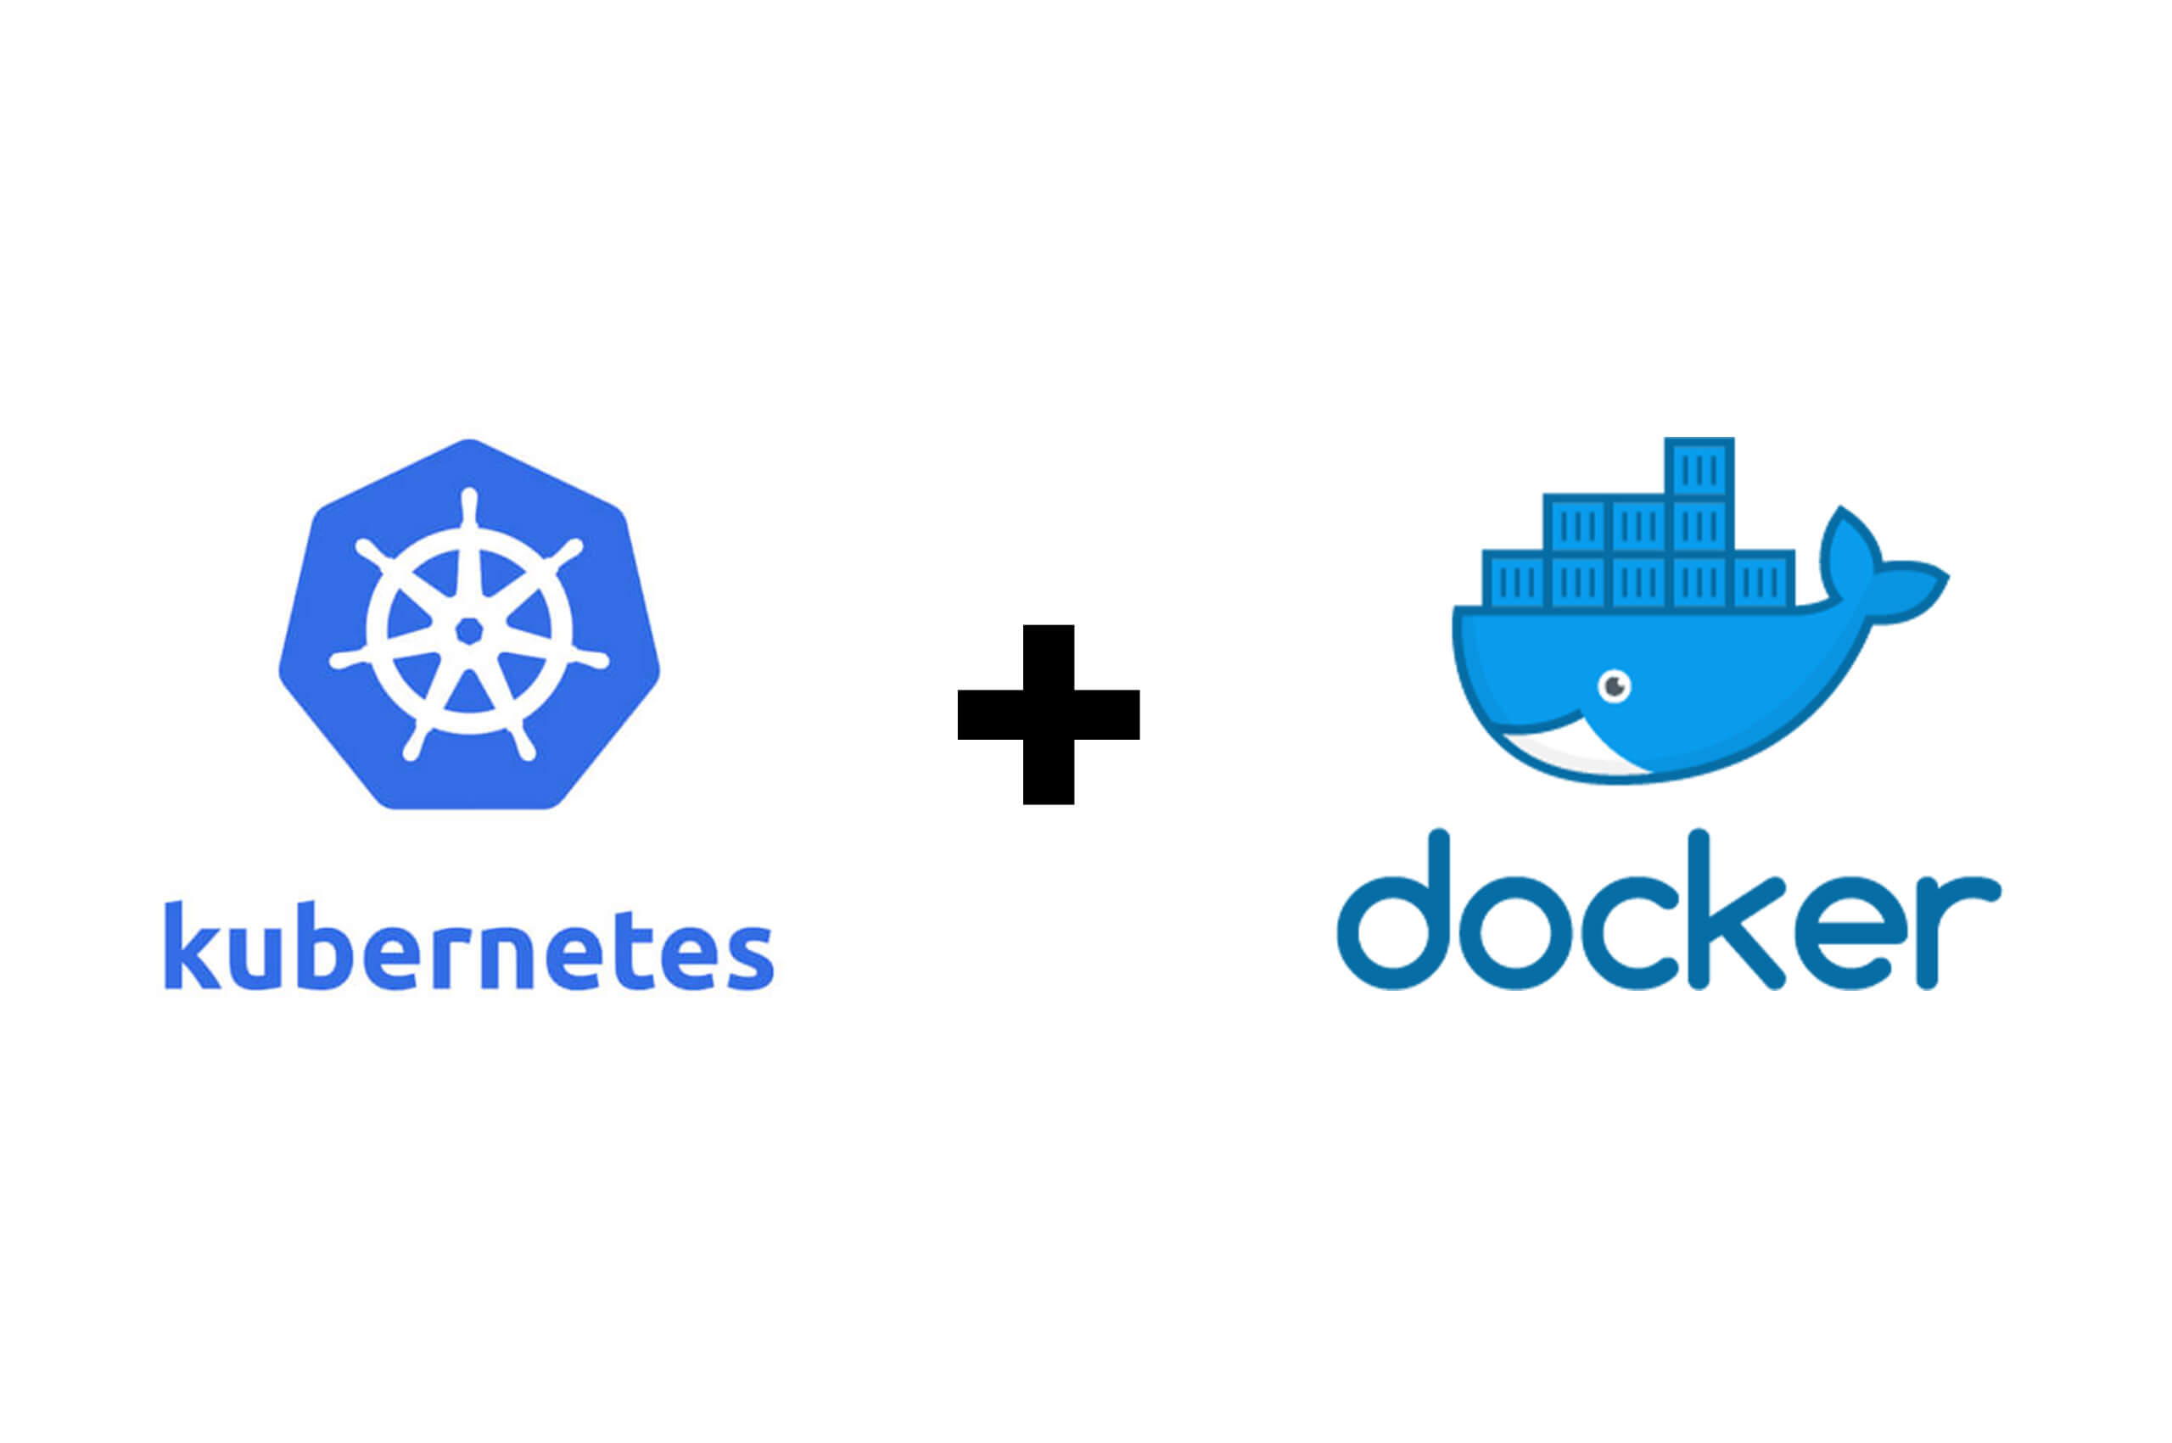
# Updating system packages
$ sudo apt update
# Installing Docker.io
$ sudo apt install docker.io
# Downloading Minikube
$ curl –LO https://storage.googleapis.com/minikube/releases/latest/minikube-linux-amd64
# Installing Minikube to /usr/local/bin
$ sudo install minikube-linux-amd64 /usr/local/bin/minikube
# Installing Kubectl via snap
$ sudo snap install kubectl --classic

Slide 3
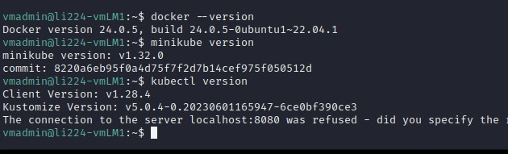

# Checking Docker version
$ docker –version
# Checking Minikube version
$ minikube version
# Checking Kubectl version
$ kubectl version

Slide 4

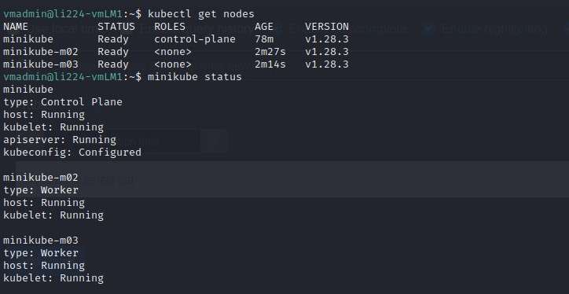
# Starting Minikube with the Docker driver
$ minikube start --driver=docker
# Adding the user to the docker group and creating a new group
$ sudo usermod -aG docker $USER && newgrp docker
# Restarting Minikube with the Docker driver
$ minikube start --driver=docker
# Adding a worker node
$ minikube node add —worker
# Adding a "worker" role label to the specified node
$ kubectl label node <nodename> node-role.kubernetes.io/worker=worker
# Listing nodes
$ kubectl get nodes

Slide 5


# Downloading and installing Helm
# curl -fsSL -o get_helm.sh https://raw.githubusercontent.com/helm/helm/main/scripts/get-helm-3
# chmod 700 get_helm.sh
# ./get_helm.sh

Slide 6
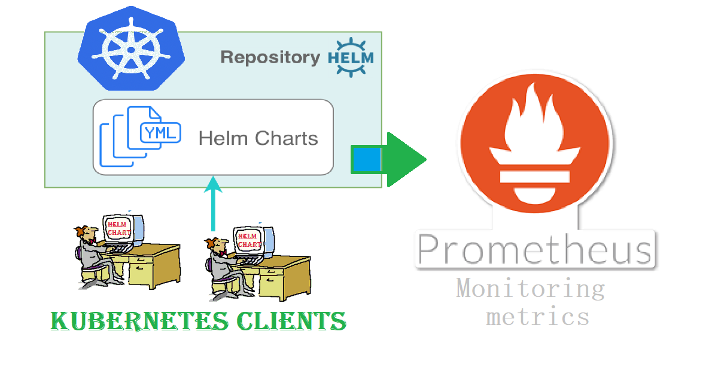
# Adding Helm repository
$ helm repo add prometheus-community https://prometheus-community.github.io/helm-charts
# Installing Prometheus
$ helm install prometheus prometheus-community/Prometheus
$ helm repo list
$ helm repo update
# Listing pods
$ kubectl get pod

Slide 7
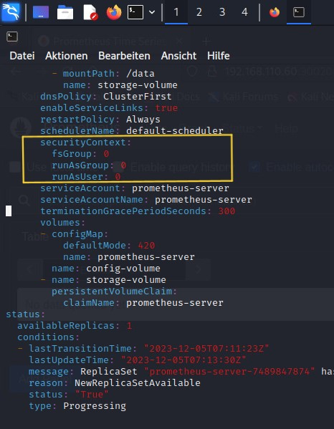
# Viewing logs of a specified Prometheus pod
$ kubectl logs prometheus-server-8fffdb69d-bn6pm
# Describing details of a specified Prometheus pod
$ kubectl describe pods prometheus-server-8fffdb69d-bn6pm
# Editing a specified deployment
$ kubectl edit deploy prometheus-server
=> securityContext:
fsGroup: 65534
runAsGroup: 65534
runAsNonRoot: true
runAsUser: 65534
to
securityContext:
fsGroup: 0
runAsGroup: 0
runAsUser: 0

Slide 8
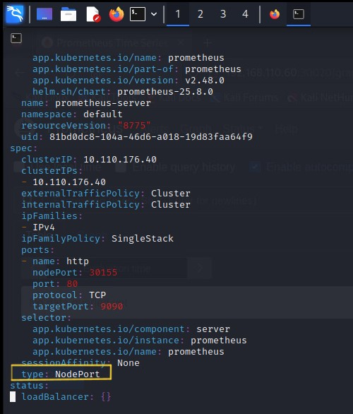
$ kubectl get svc
# Editing a specified service
$ kubectl edit svc prometheus-server
=>ClusterIp instead of NodePort

Slide 9
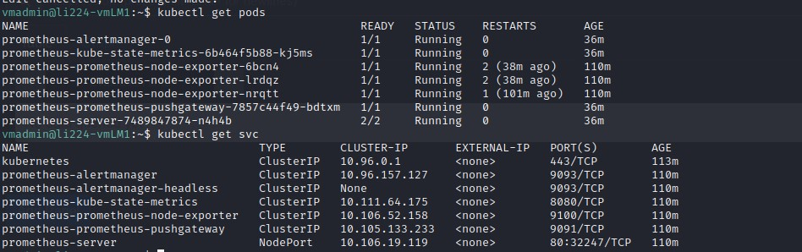
$ kubectl get pods
$ kubectl get svc

Slide 10
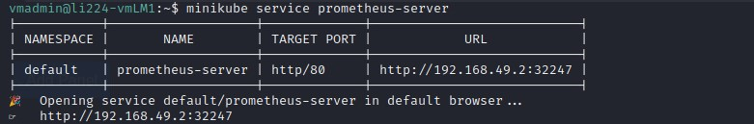
# Checking firewall status
$ sudo ufw status
# Allowing a specified port (30020) through the firewall
$ sudo ufw allow 30020
# Running Minikube service
$ minikube service prometheus-server

Slide 11
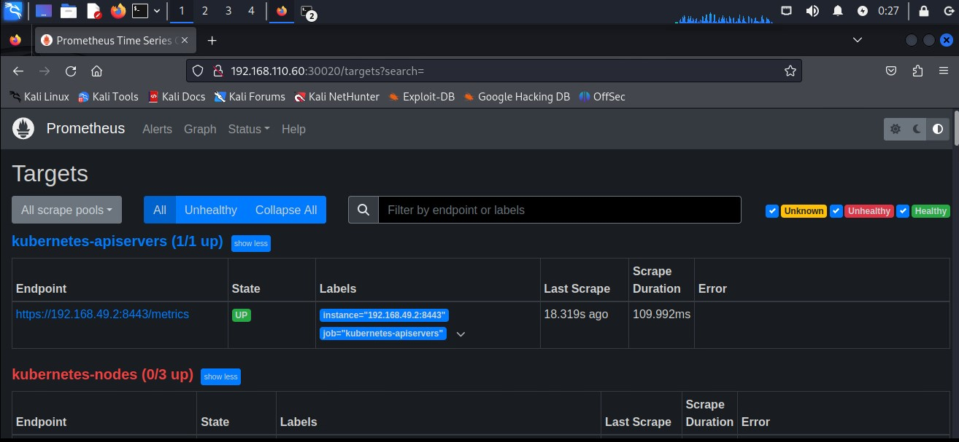
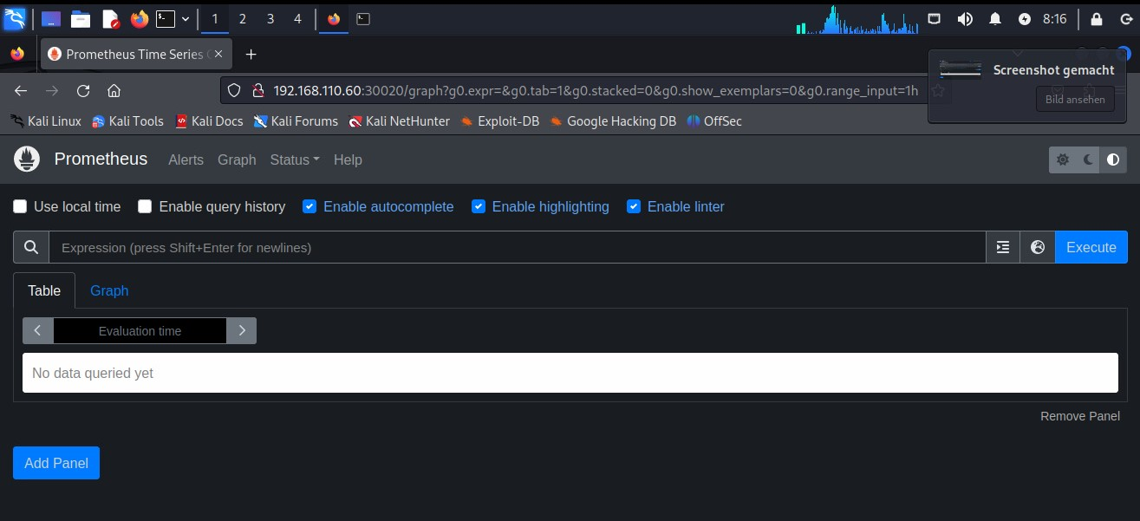
# Creating a connection between the specified IP and port using socat
$ sudo apt-get install -y socat
$ sudo socat TCP-LISTEN:30020,fork TCP:192.168.49.2:30155

Slide 12
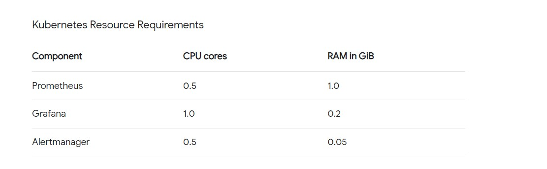
Kubernetes Resource Requirements

Slide 13

Grafana Install
My YAML file contains both a Deployment (defining the resources required to run the application), a PVC (Persistent Volume Claim) and a Service (configuration to expose the service to the outside world) in a Kubernetes environment. This file contains the definitions of the various resources to enable the deployment of an application, persistent storage claims and the availability of the service.
Yaml => https://github.com/kereciyasin/k8s-tutorial.git

Slide 14

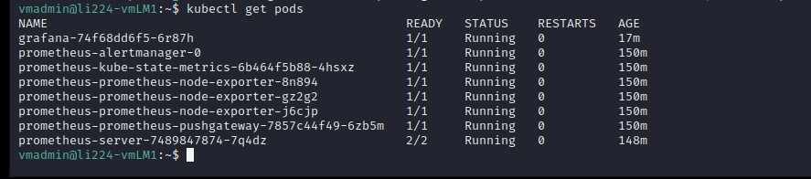
$ kubectl get pods

Slide 15

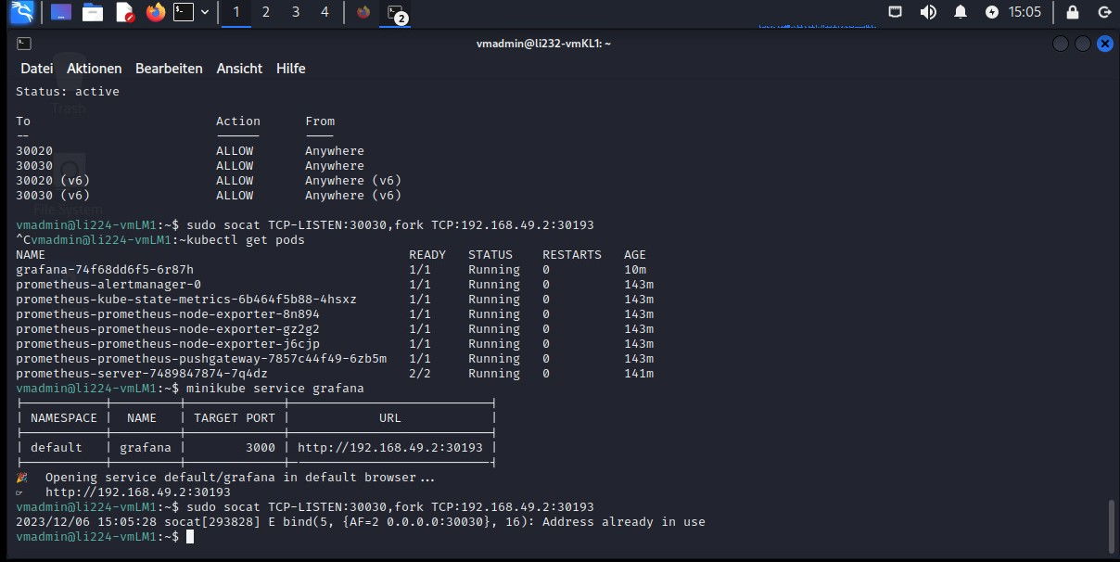

# Service
$ minikube service grafana

Slide 16

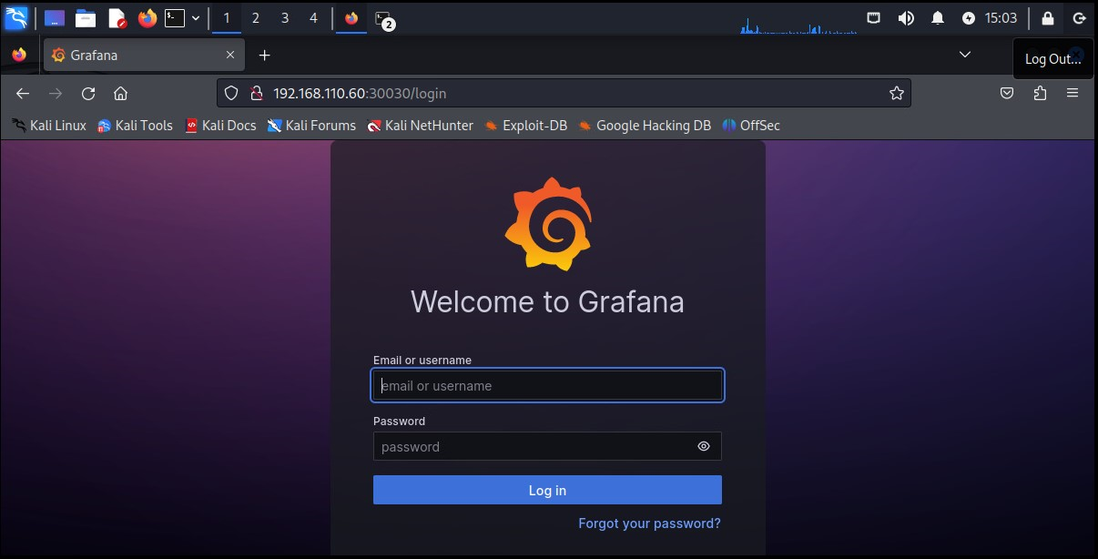
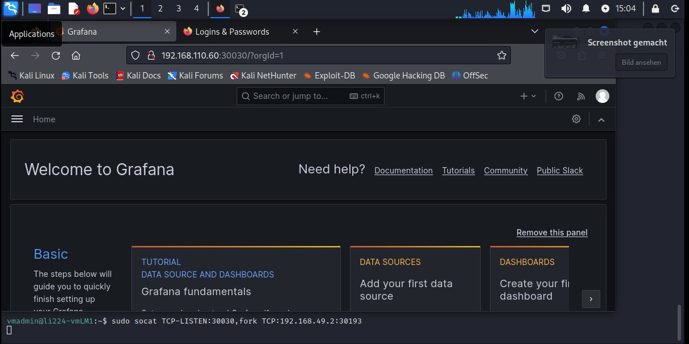

Slide 17
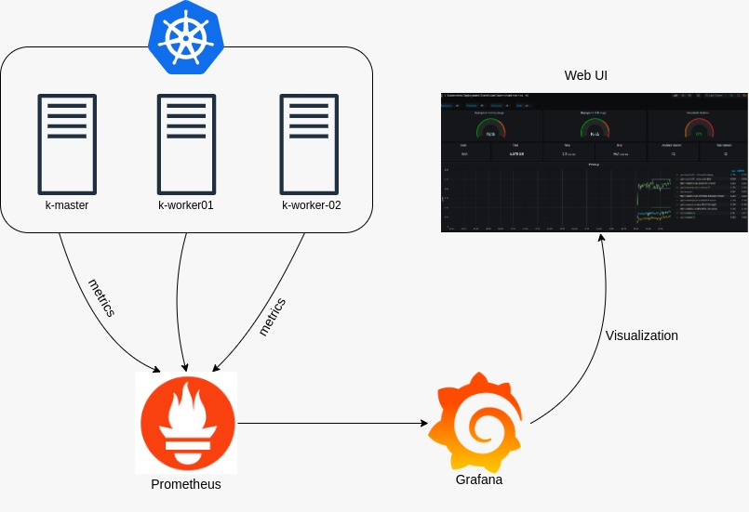
Architekturübersicht
192.168.110.60/30030/login

Slide 18
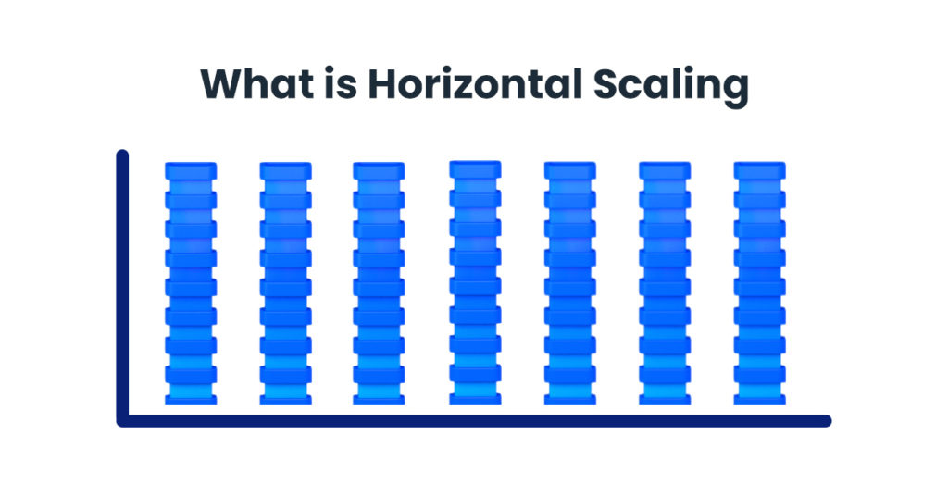
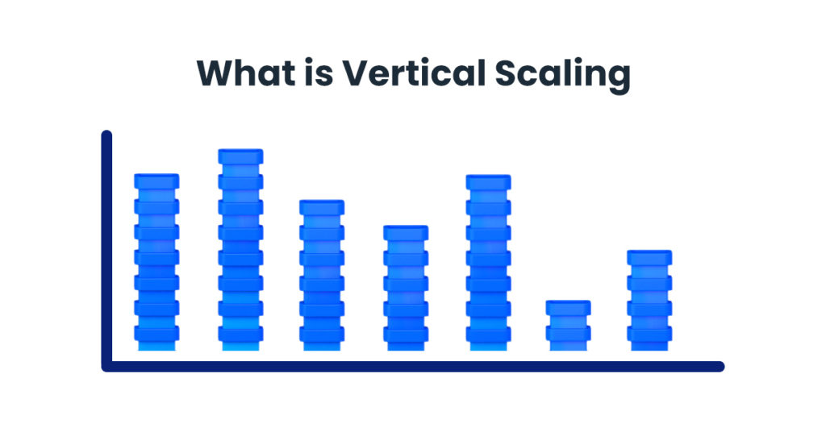
Die vertikale Skalierung ist für meine Produktion geeignet. Es zieht automatisch aus dem System, wenn es Ressourcen benötigt.

Slide 19
Here are the advantages of using clusters
High Availability: By bringing together multiple servers or resources, a single point of failure is avoided, preventing disruptions to system performance. Other resources take over, preventing service outages.
Resource Management and Automatic Scaling: Cluster structures enable efficient resource utilization. Automatic scaling allows resources to be increased or decreased based on demand.
Orchestration and Easy Management: Bringing together and managing multiple resources becomes easier. Orchestration tools facilitate efficient and organized resource management.
Security: Clusters distribute data and services, making them more secure. Issues at one point don’t affect other components, thereby minimizing security vulnerabilities.
Flexibility and Easy Communication: Cluster structures allow easy communication between different components. This facilitates flexible interaction between various services.

